Slide 1
Ionic Defender
Pitch from April 11th 2021
Led by Greg, releasing on June 27th 2021

Slide 2

Meet JustGreg
(Grygoriy Kulesko)
First time project lead
Two times game changer
Contributed mainly programming to witches-and-guns, grimsnap and daggers-gate

Slide 3
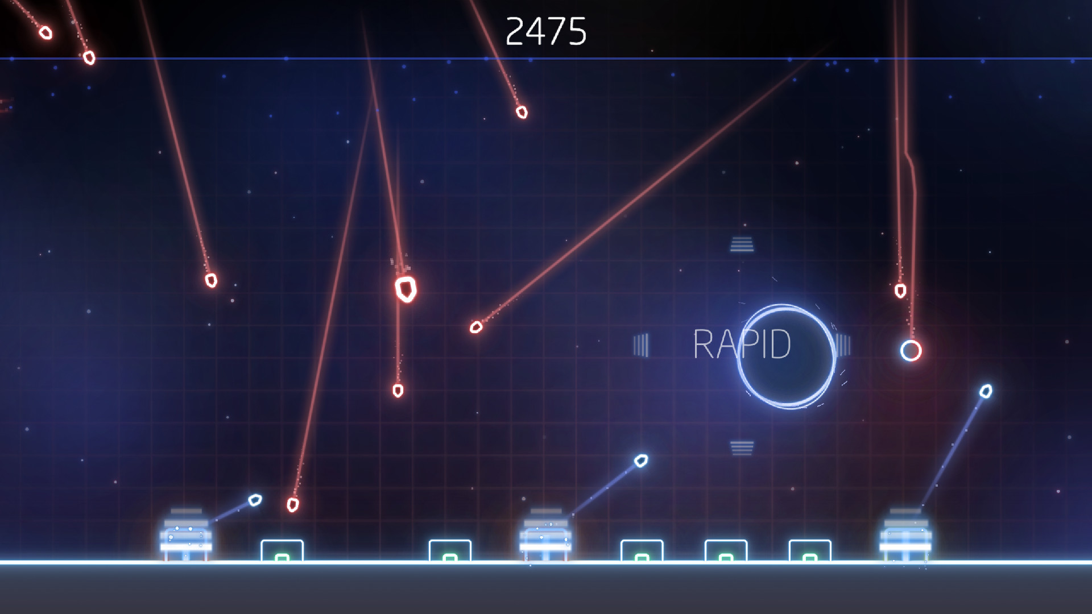
Inspiration for gameplay
Missile Command (orginal release 1980)
arcady 2.5D defense
But we’re doing it with tower defense-ish upgrades in a Sci-Fi setting

Slide 4
Inspiration for
gamefeel
Resogun (ps4)
crammed view, style, effects, pulse wave

Slide 5
Inspiration for
the tone
Azura's Wrath
defending against epic, overwhelming appearing cosmic danger

Slide 6
Demo Time!

Slide 7
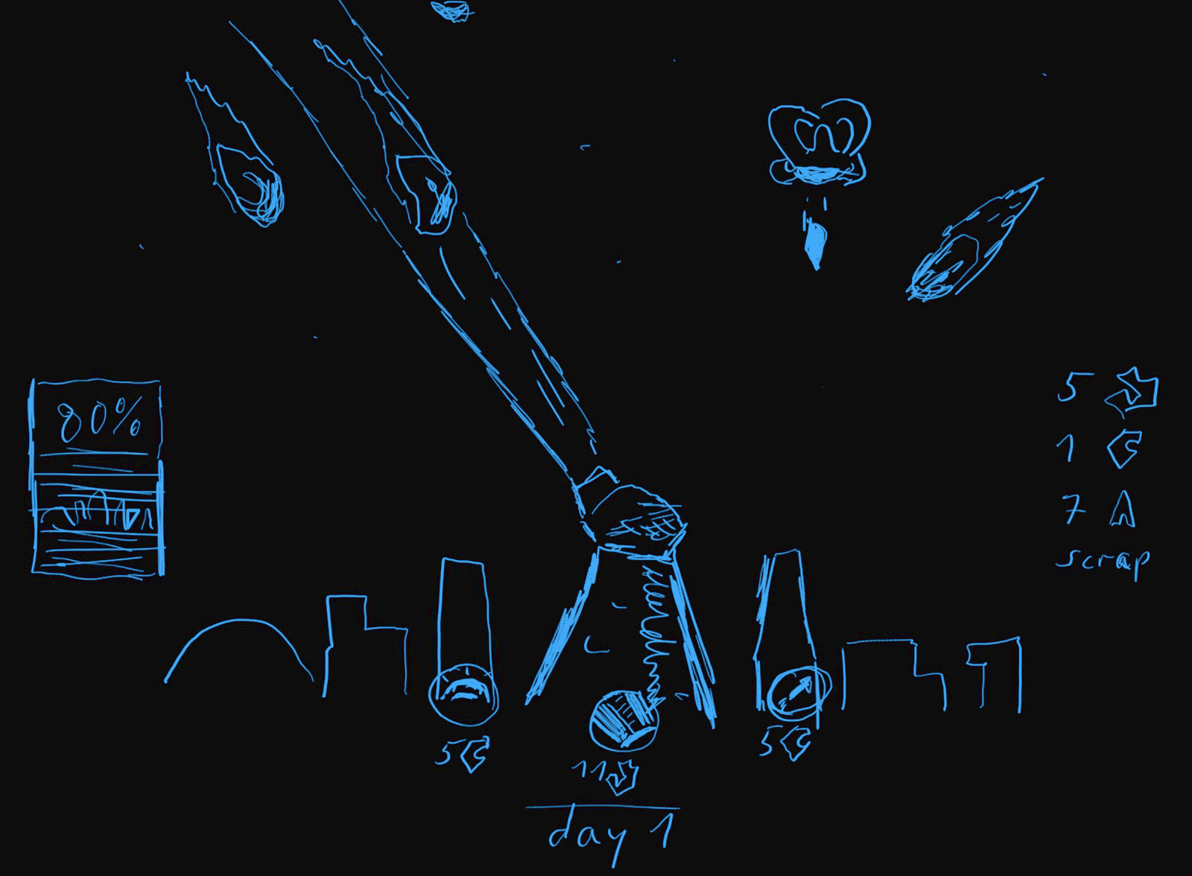

Slide 8
TABLE OF CONTENTS
01
Goal
02
Game-Over
03
Laser-Turret
04
Upgrades
Survive wave after wave
Total HP reaches zero
use a powerful laser beam vaporize the enemies
Collect scrap left by enemies as reward

Slide 9
Schedule is up on trello!

Slide 10
Things you can do!
Programming
Music
3D Art
Sound effects
enemy AI, procgen waves, arcade style UI
electric, chiptune, maybe with rock parts
Asteroids, weird alien enemies, turrets and skyline
Epic 2D icons and stellar background welcome!
Sci-Fi laser and pew pew sounds, also enemy and building explosions

Slide 11
Come join us in
#team-ionic-defender

Slide 12


